Slide 1


Case 1
Mark
Diabetes & Cardiovascular Disease

Slide 2

Learning Objectives
Upon completion of this case based session, participants will be able to:
01
Assess your patients with diabetes for risk of macro and microvascular disease
02
Use the ABCDES of vascular protection for your patients with diabetes
03
Use appropriate additional therapies to help reach the LDL-C target

Slide 3


Case 1
Follow Up Diabetes Visit
Mark
63 years old
Mark’s History
T2DM for 8 years
Myocardial Infarction 3 years ago (DES stent)
Hypertension x 10 years
Past smoker
Physical Exam
BMI 32.6 kg/m²
BP 128/78 mmHg
HR 78 regular
No Retinopathy
No Neuropathy
Rest of exam normal
DES: drug eluting stent

Slide 4


Case 1
Follow Up Diabetes Visit
Medications
Mark
63 years old
Metformin/Sitagliptin 50/1000 mg BID
Empagliflozin 10 mg OD
ASA 81 mg
Rosuvastatin 20 mg OD (unable to tolerate 40 mg due to myalgias)
Ezetimibe 10 mg OD
Ramipril 10 mg OD
Amlodipine 10mg OD
Labs
A1C 6.9%
eGFR 64 ml/min
ACR 5 mg/mmol
TC 4.3 mmol/L
LDL-C 2.4 mmol/L
HDL-C 1.1 mmol/L
TG 1.5 mmolL

Slide 5

Which of the following macrovascular complications does Mark have?
Please select from one of the available options
Stroke/TIA
MI/Bypass/Stent
PAD
None
Notes:
Correct Answer: MI & Stent

Slide 6
Which of the following microvascular complications does Mark have?
Please select from one of the available options
Retinopathy
Nephropathy
Neuropathy
None
Notes:
Correct Answer: Correct Answer: Nephropathy

Slide 7
Case 1
Mark
63 years old
Mark’s History
T2DM for 8 years
Myocardial Infarction 3 years ago (DES stent)
Hypertension x 10 years
Past smoker
Physical Exam
BMI 32.6 kg/m²
BP 128/78 mmHg
HR 78 regular
No Retinopathy
No Neuropathy
Rest of exam normal
DES: drug eluting stent

Slide 8
Case 1
Medications
Mark
63 years old
Metformin/Sitagliptin 50/1000 mg BID
Empagliflozin 10 mg OD
ASA 81 mg
Rosuvastatin 20 mg OD (unable to tolerate 40 mg due to myalgias)
Ezetimibe 10 mg OD
Ramipril 10 mg OD
Amlodipine 10mg OD
T2DM for 8 years
Myocardial Infarction 3 years ago (DES stent)
Hypertension x 10 years
Labs
A1C 6.9%
eGFR 64 ml/min
ACR 5 mg/mmol
TC 4.3 mmol/L
LDL-C 2.4 mmol/L
HDL-C 1.1 mmol/L
TG 1.5 mmolL

Slide 9
How well are we doing in terms of Mark’s Vascular Protection checklist for diabetes?
Please select from one of the available options
Well
Well enough
Needs Improvement
Not sure
Notes:
Correct Answer: Needs Improvement LDL-C is 2.4 mmol/L

Slide 10



Vascular Protection Checklist
A
A1C – optimal glycemic control (usually ≤7%)
B
BP – optimal blood pressure control (< 130/80 mmHg)
C
Cholesterol – LDL-C <2.0 mmol/L or >50% reduction if treatment is indicated
D
Drugs to protect the heart
A – ACEi or ARB │S – Statin │A – ASA if indicated│SGLT2i / GLP-1RA →
with demonstrated CV benefit if type 2 DM with CVD and A1C not at target
E
Exercise / Healthy Eating
S
Smoking cessation
ACEi, angiotensin converting enzyme inhibitor; ARB, angiotension receptor blocker; CV, cardiovascular; CVD, cardiovascular disease; DM, diabetes mellitus
Diabetes Canada Clinical Practice Guidelines Expert Committee. Diabetes Canada 2018 Clinical Practice Guidelines for the Prevention and Management of Diabetes in Canada. Can J Diabetes. 2018;42(Suppl 1):S1-S325

Slide 11


Case 1
Vascular Protection Checklist
Mark
A • A1C ≤7%
B • BP <130/80 mmHg
C • LDL-C ≤2.0 mmol/L
D • Drugs to protect the heart
A – ACEI or ARB
S – Statin
A – ASA if indicated
SGLT2i / GLP-1RA
E • Exercise/Eating
S • Smoking cessation
A • A1C 6.9%
B • BP 128/78 mmHG
C • LDL-C 2.4 mmol/L
D • Drugs to protect the heart
Ramipril 10 mg
Rosuvastatin 20 mg (ezetimibe 10 mg)
ASA 81 mg
Empagliflozin 10 mg
E • Exercise/Eating – Trying
S • Smoking cessation – Doesn’t Smoke
Diabetes Canada Clinical Practice Guidelines Expert Committee. Diabetes Canada 2018 Clinical Practice Guidelines for the Prevention and Management of Diabetes in Canada. Can J Diabetes. 2018;42(Suppl 1):S1-S325

Slide 12
What would be your next step with respect to Mark’s cholesterol management?
Please select from one or more of the available options
Add a BAS*
Add a fibrate
Add niacin
Add a PCSK9 inhibitor
No changes to current management
Refer to a specialist
BAS = Bile Acid Sequestrant
Notes:
For discussion – based on guideline recommendations an addition of a PCSK9 inhibitor should be considered

Slide 13
Lipid Abnormalities in Type 2 Diabetes
Normal
Type 2 Diabetes
↑ VLDL production
↓ VLDL catabolism
↑ % of large VLDL
VLDL
↓ LDL catabolism
↑ small, dense LDL
↑ oxidized LDL
↑ glycated LDL
LDL
HDL
↑ HDL catabolism
↑ glycated HDL
↓ small, dense HDL
Apo, apolipoprotein; HDL, high-density lipoprotein; LDL, low-density lipoprotein; VLDL, very low-density lipoprotein.
Adapted from Vergès B. Diabetologia. 2015;58:886-99

Slide 14
Cholesterol Treatment Trialists’ Collaboration Lipid Lowering Benefits of Statins in Diabetes
14 randomized trials of statin therapy
Treatment duration ≥2 years | Mean follow-up of 4.3 years
N=71,370 without diabetes | N=18,686 with diabetes
21%
major vascular events
13%
all-cause mortality
Without diabetes
1 mmol/L
LDL-C
21%
major vascular events
9%
all-cause mortality
With diabetes
Adapted from Cholesterol Treatment Trialists' (CTT) Collaborators. Lancet. 2008;371:117-25.

Slide 15
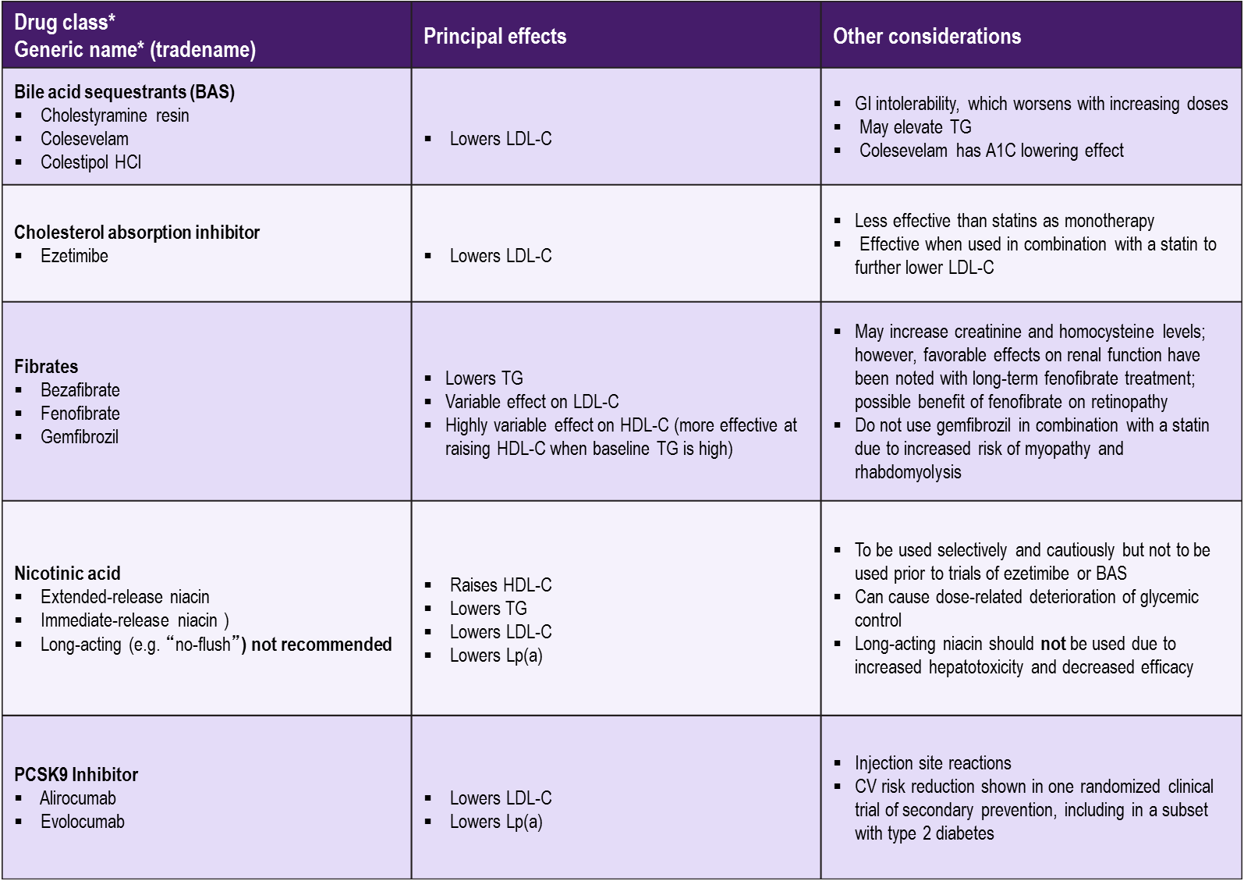
Second-Line Lipid-Modifying Medications
Diabetes Canada Clinical Practice Guidelines Expert Committee. Diabetes Canada 2018 Clinical Practice Guidelines for the Prevention and Management of Diabetes in Canada. Can J Diabetes. 2018;42(Suppl 1):S1-S325

Slide 16
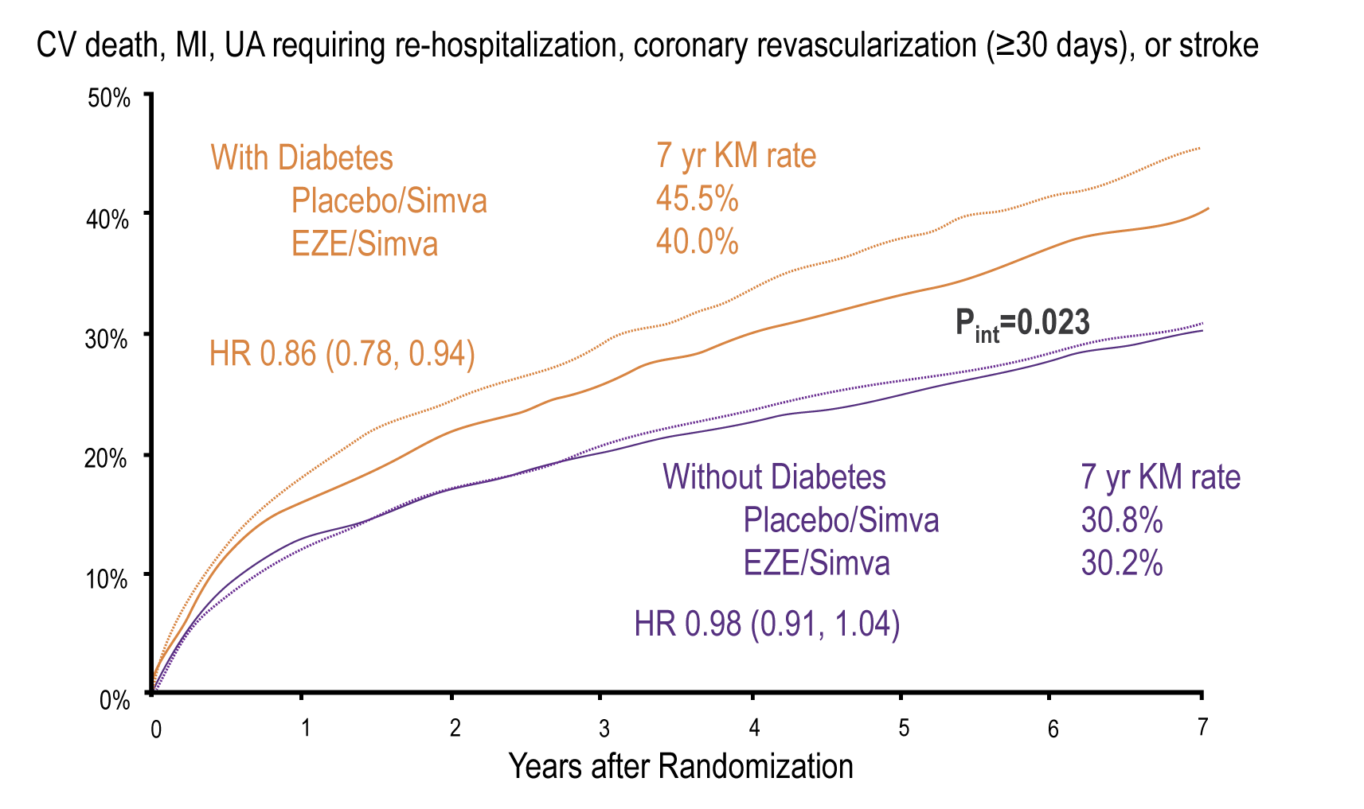
IMPROVE-IT Ezetimibe Add-on to Simvastatin was Beneficial in Persons with ACS and Diabetes
CV, cardiovascular; MI, myocardial infarction; UA, unstable angina.
Giguliano RP et al. Benefit of adding ezetimibe to statin therapy on cardiovascular outcomes and safety in patients with vs without diabetes: the IMPROVE-IT trial.. Presented at the European Society of Cardiology Congress; August 30, 2015; London, England.

Slide 17
Recommendations for Lipid Management in Diabetes
For people with diabetes with indications for lipid-lowering therapy, treatment should be initiated with a statin¹ to achieve LDL-C consistently <2.0 mmol/L² or >50% reduction of LDL-C from baseline³.
Alternative targets and respective goals are apo B <0.8 g/L and non-HDL-C <2.6 mmol/L⁴ .
1 [Grade A, Level 1]
2 [Grade C, Level 3]
3 [Grade D, Consensus]
4 [Grade C, Level 3]
Diabetes Canada Clinical Practice Guidelines Expert Committee. Diabetes Canada 2018 Clinical Practice Guidelines for the Prevention and Management of Diabetes in Canada. Can J Diabetes. 2018;42(Suppl 1):S1-S325

Slide 18
Many High-Risk Canadian Patients Treated with Statins Are Not at LDL-C Goal
DYSIS¹
Canadian high-risk patients are NOT at LDL-C target^{1*} (< 2.0 mmo/L)
88% of patients received a ‘potent’ statin with suboptimal dose
14% of patients received additional lipid-lowering agent
45%
DM-SCAN²
Canadian patients with diabetes are NOT at LDL-C target† (≤ 2.0 mmo/L)
82% of patients were on a lipid-lowering agent
43%
*High risk = coronary artery disease, peripheral arterial disease, cerebrovascular disease, diabetes mellitus or Framingham 10-year risk score ≥20%. DYSIS Study – 2,436 patients, 1913 high risk patients.
†N = 5,069
1. Goodman SG et al. on behalf of the DYSIS Canadian Investigators. Can J Cardiol. 2010;26:e330-e335. 2. Leiter LA et al. on behalf of the DM-SCAN investigators. Can J Diabetes. 2013;37:82-89.
Notes:
Speaker’s Notes:
Cross-sectional study recruited 2436 outpatients 45 years of age or older who were treated with statins by 232 physicians from 10 provinces; all underwent clinical examination and had their latest fasting lipid values while on statin therapy recorded.
The authors concluded that this observational study highlights the need for more intensive treatment of lipid abnormalities, particularly among high-risk patients.
Further, the findings suggest the possibility that, in addition to optimizing adherence, there remains an important need to titrate current statin therapy to higher doses and potentially use a combination of lipid-modifying treatments (once the statin dose has been truly maximized) to further bridge the gap between evidence-based medicine and current Canadian practice
Reference:
Goodman SG, et al., on behalf of the DYSIS Canadian Investigators. Prevalence of dyslipidemia in statin-treated patients in Canada: Results of the DYSlipidemia International Study (DYSIS). Can J Cardiol 2010;26(9):e330-e335.

Slide 19


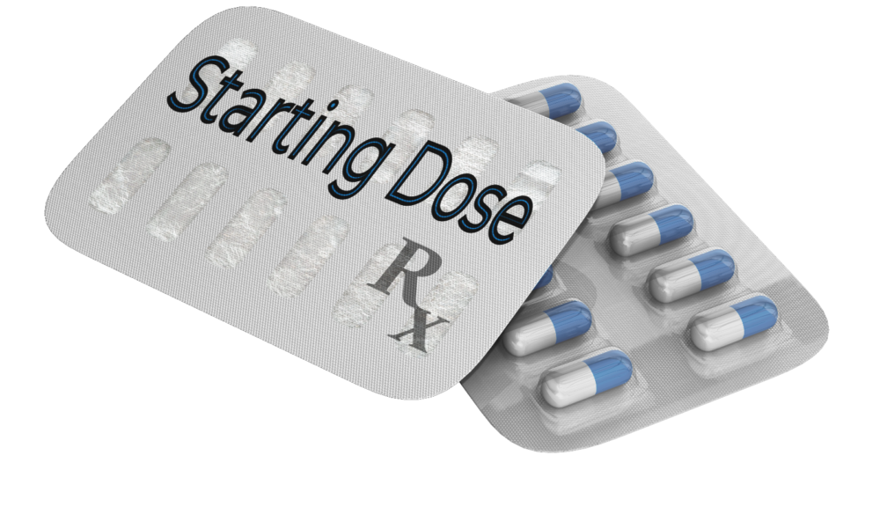






Why are Cholesterol Targets Not Achieved?
Over reliance on diet
Others
Use of insufficient starting doses
Fear of side effects of statins
Inability to reach more aggressive targets even with high dose statin
Confusion around recommended lipid targets
Complacency with sub-optimal cholesterol values achieved
Lack of follow-up for uptitration

Slide 20
Evolocumab Cardiovascular Outcomes Trial: Study Population
FOURIER: Further cardiovascular OUtcomes Research with PCSK9 Inhibition in subjects with Elevated Risk
Screening
Age 40-85 years
MI, Stroke or PAD
Additional risk factors (one major or two minor)
Optimal background lipid therapy (including effective dose of statin ± ezetimibe)
LDL-C ≥ 1.81 mmol/L or non HDL-C ≥ 2.59 mmol/L
Randomization 1:1
Evolocumab SC
140 mg Q2W or 420 mg QM
(per subject preference)
n ~ 13,750
End of Study (EOS)
Placebo SC
Q2W or QM
(per subject preference)
n ~ 13,750
Maximum approximately 15 weeks
D1
W4
W12
W24
Q24W
Number of key 2○
endpoints
Background lipid-lowering therapy
Patients must be on an optimized lipid-lowering regimen (moderate to high intensity statin +/- ezetimibe)
In general, patients are not to change open-label background lipid-lowering therapies after randomization
Sabatine MS, et al . N Engl J Med 2017; 376:1713-1722
Notes:
Notes:

Slide 21
FOURIER: Diabetes at Baseline
Diagnosis of diabetes:
Median duration 5.7 y (IQR 1.9-11.9)
25% taking insulin
Sabatine MS et al; Lancet Diabetes Endocrinol. 2017 Dec;5(12):941-950.
Notes:
Notes:

Slide 22
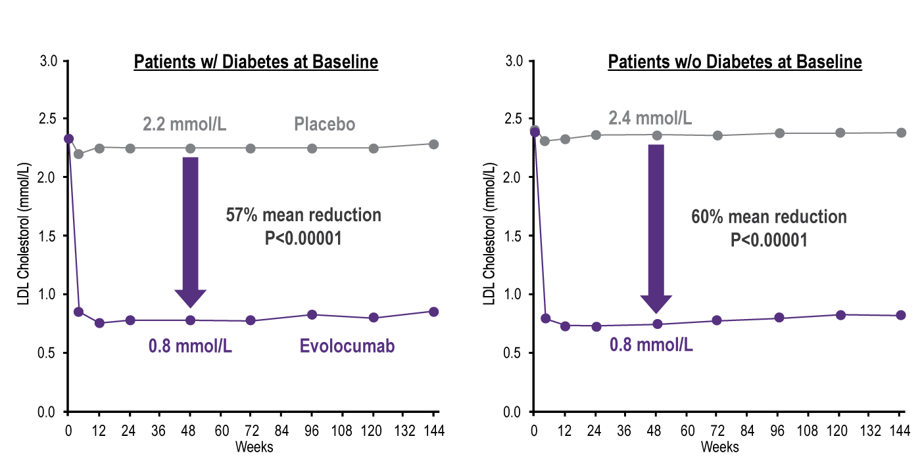
FOURIER: LDL-C Reduction with Evolocumab
Sabatine MS et al; Lancet Diabetes Endocrinol. 2017 Dec;5(12):941-950.
Notes:
Notes:

Slide 23
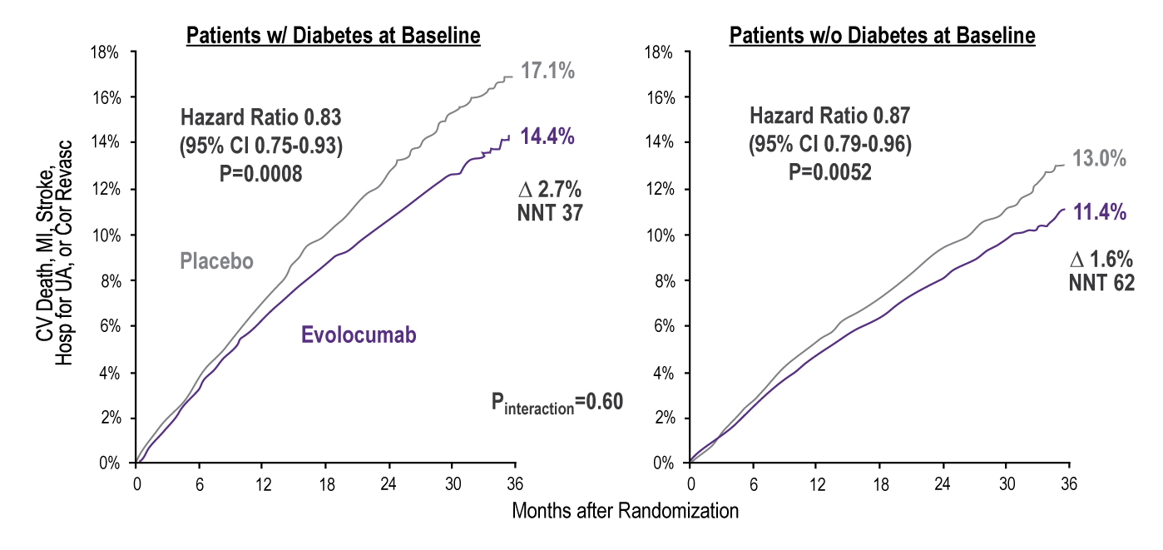
FOURIER:
Effect of Evolocumab on Primary Endpoint
Sabatine MS et al; Lancet Diabetes Endocrinol. 2017 Dec;5(12):941-950.
Notes:
Notes:

Slide 24
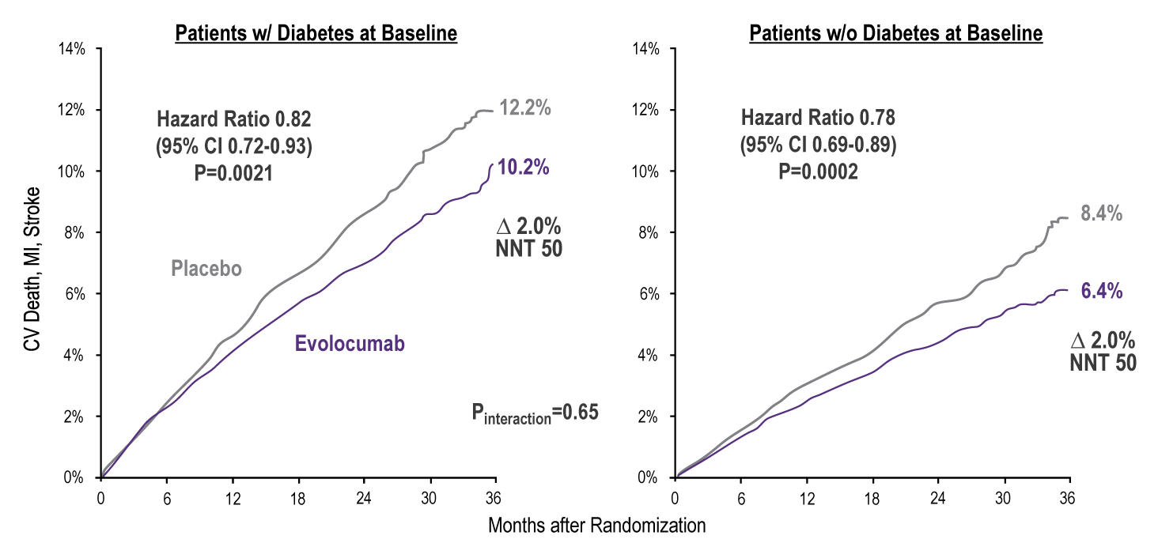
FOURIER:
Effect of Evolocumab on Key Secondary Endpoint
Sabatine MS et al; Lancet Diabetes Endocrinol. 2017 Dec;5(12):941-950.
Notes:
Notes:

Slide 25
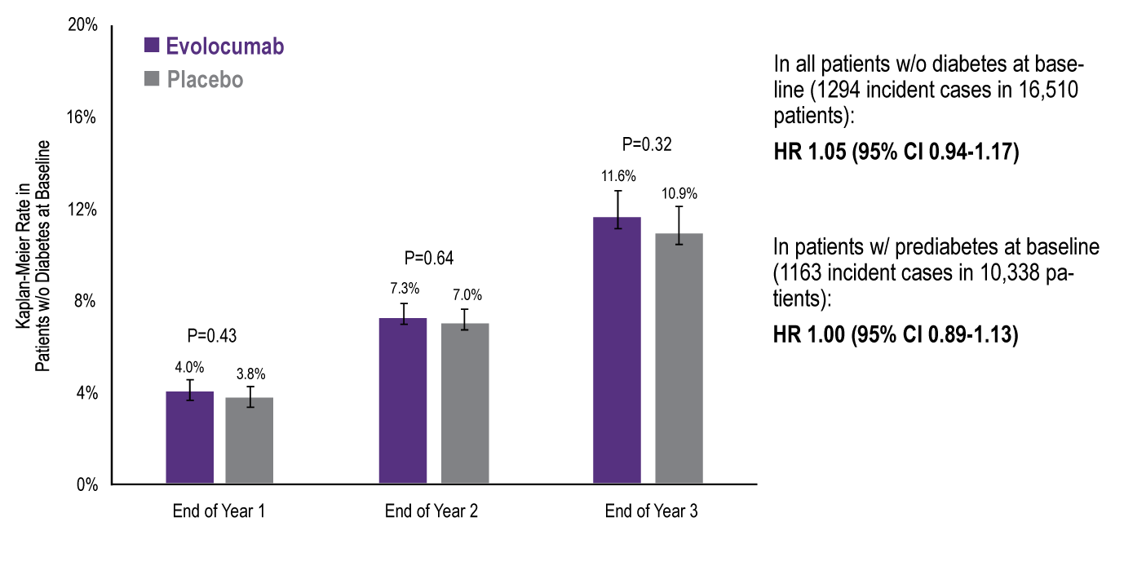
FOURIER: New-Onset Diabetes
Sabatine MS et al; Lancet Diabetes Endocrinol. 2017 Dec;5(12):941-950.
Notes:
Notes:
Levels of HbA_{1c} and FPG were similar between the evolocumab and placebo groups over time in patients with diabetes, prediabetes, or normoglycaemia.

Slide 26
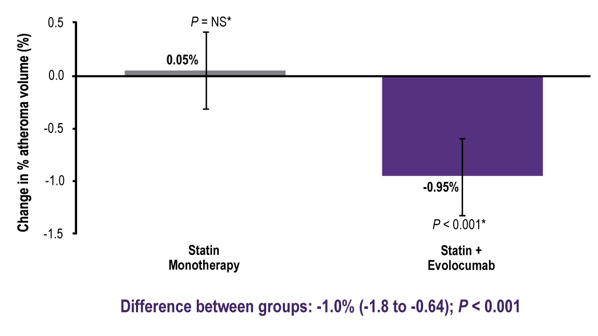
GLAGOV: Primary Endpoint
Nominal Change in PAV from Baseline to Week 78
Nicholls SJ, et al. JAMA. 2016;316(22):2373-2384. doi:10.1001/jama.2016.16951
Notes:
Notes:

Slide 27
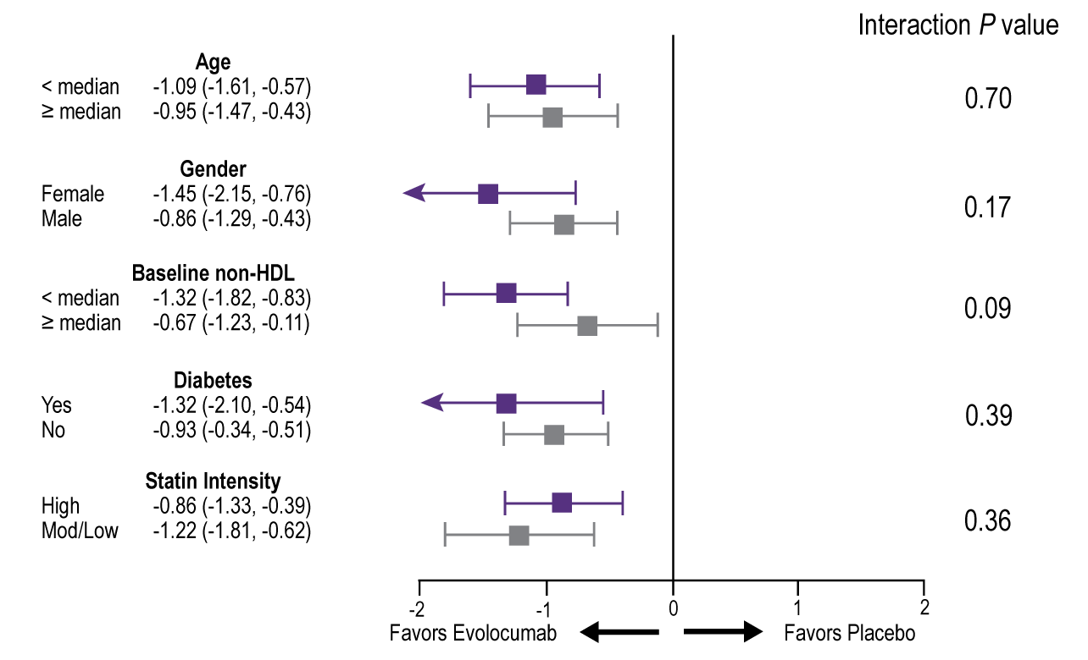
GLAGOV:
Interaction: Selected Prespecified Subgroups (PAV)
Nicholls SJ, et al. JAMA. 2016;316(22):2373-2384. doi:10.1001/jama.2016.16951
Notes:
Notes:

Slide 28

Placeholder
Pending Results of the Diabetes sub-group analyses
ODYSSEY Outcomes – Anticipated June 2018
Notes:
Notes:

Slide 29
2016 Canadian Guidelines for
Management of Dyslipidemia
Statin-Indicated Conditions
(genetic dyslipidemia)
Discuss behavioral modifications
Initiate Statin Treatment : Treat to Target Approach
LDL-C <2.0 mmol/L or >50% reduction or apoB <0.8 g/L or
non HDL-C <2.6 mmol/L
LDL-C >50% reduction
Target achieved on maximally tolerated dose?
NO
NO
Discuss add-on therapy with patient
ADD
ON
ADD
ON
Add-on Therapy
Ezetimibe as 1st line (BAS as alternative)
PCSK9 inhibitors as 2nd line (add on to other drugs)
Ezetimibe (or BAS) or PCSK9 inhibitors
LDL-C<15-20% away from target: addition of ezetimibe is likely to achieve target
LDL-C> 20% away from target: no add-on drug other than a PCSK9 inhibitor is likely to achieve target
Anderson and al., Can Journal of Cardiol, 32 (11); 1263-82.
Apo, apolipoprotein; BAS, bile acid sequestrant; LDL-C, low-density lipoprotein cholesterol; non-HDL-C, non-high-density lipoprotein cholesterol.
Notes:
Notes:
Treatment Algorithm:
Discuss Behavioral Modifications:
We recommend combining low-risk lifestyle behaviours that include achieving and maintaining a healthy body weight, healthy diet, regular physical activity, moderate alcohol consumption, and moderate sleep duration to achieve maximal CVD risk reduction (Strong Recommendation; High-Quality Evidence).
Values and preferences. Low-risk lifestyle behaviours are variably defined as follows: a healthy body weight (body mass index of 18.5-25 to < 30 kg/m2 or waist circumference of < 88 cm for women or < 95 to < 102 cm for men), healthy diet (higher fruits and vegetables Mediterranean dietary pattern), regular physical activity (1 time per week to 40 min/d plus 1 h/wk of intense exercise), smoking cessation (never smoked to smoking cessation for > 12 months), moderate alcohol consumption ( 12-14 g/mo to 46 g/d), and moderate sleep duration (6-8 hours per night). Individuals can achieve benefits in a dose-dependent manner.
Statin indication conditions:
Clinical Atherosclerosis:
Myocardial Infarction
Acute Coronary Sydromes
Stable Angina
Documented Coronary Disease by angiography (>10% stenoses)
Stroke
TIA
Documented Carotid Disease
Peripheral Artery Disease
Claudication and/or ABI < 0.9
Abdominal Aortic Aneurysm:
Abdominal Aorta > 3.0 cm or
Previous aneurysm surgey
Diabetes Mellitus:
 40 years of age or
> 15 years duration and age ≥ 30 years or
Microvascular complications
Chronic Kidney Disease:
> 3 months duration and
ACR > 3.0 mg/mmol or
eGFR < 60 mL/min/1.73 m2
LDL-C ≥ 5.0 mmol/L:
LDL-C ≥ 5.0 mmol/L or
Document Familial hypercholesterolemia
Excluded 2nd causes
Treat to target approach:
We recommend a treat-to-target approach in the management of dyslipidemia to mitigate CVD risk (Strong Recommendation; Moderate-Quality Evidence).
Statin-indicated conditions
1. We recommend a target LDL-C level consistently < 2.0 mmol/L or > 50% reduction of LDL-C for individuals
for whom treatment is initiated to decrease the risk of CVD events and mortality (Strong Recommendation; Moderate-Quality Evidence). Alternative target variables are apoB < 0.8 g/L or non- HDL-C < 2.6 mmol/L (Strong Recommendation; Moderate-Quality Evidence).
2. We recommend a > 50% reduction of LDL-C for patients with LDL-C > 5.0 mmol/L in individuals for whom treatment is initiated to decrease the risk of CVD events and mortality (Strong Recommendation; Moderate-Quality Evidence).
Values and preferences. On the basis of the IMPROVE-IT trial, for those with a recent acute coronary syndrome and established coronary disease consideration should be given to more aggressive targets (LDL-C < 1.8 mmol/L or > 50% reduction). This might require the combination of ezetimibe (or other nonstatin medications) with maximally tolerated statin. This would value more aggressive treatment in higher-risk individuals. Primary prevention conditions warranting therapy, all risk groups
3. We recommend a target LDL-C consistently < 2.0 mmol/L or > 50% reduction of LDL-C in individuals for whom treatment is initiated to decrease the risk of CVD events (Strong Recommendation; Moderate- Quality Evidence).
Alternative target variables are apoB < 0.8 g/L or non-HDL-C < 2.6 mmol/L (Strong Recommendation; Moderate-Quality Evidence).
Values and preferences. According to evidence from randomized trials in primary prevention, achieving these levels will reduce CVD events. The mortality reduction is statistically significant but modest (NNT = 250). Treatment in primary prevention values morbidity reduction preferentially.
Add-on therapy:
We recommend ezetimibe as second-line therapy to lower LDL-C levels in patients with clinical CVD if targets are not reached with maximally tolerated statin therapy (Strong Recommendation; High-Quality Evidence).
We recommend that niacin not be combined with statin therapy for CVD prevention in patients who have achieved LDL-C targets (Strong Recommendation; High-Quality Evidence).
Values and preferences. It remains unclear whether niacin offers CV benefits in other patient groups, such as those with LDL-C above target levels or those with low HDL-C or high triglyceride levels.
3. We recommend that fibrates not be combined with statin therapy for CVD event prevention in patients who have achieved LDL-C targets (Strong Recommendation; High-Quality Evidence).
Values and preferences. In subgroup analysis, patients with elevated triglyceride levels and low HDL-C levels might benefit from fibrate therapy.
4. We suggest that BASs be considered for LDL-C lowering in high-risk patients whose levels remain above target despite statin treatment with or without ezetimibe therapy (Conditional Recommendation; Low-Quality Evidence).
5. We suggest the use of PCSK9 inhibitors (evolocumab, alirocumab) to lower LDL-C for patients with heterozygous
familial hypercholesterolemia whose LDL-C level remains above target level despite maximally tolerated statin therapy (Conditional Recommendation; Moderate-Quality Evidence).
We suggest that evolocumab be combined with background therapy in patients with homozygous familial hypercholesterolemia and continued if LDL-C lowering is documented (Conditional Recommendation; Moderate-
Quality Evidence).
6. We suggest that PCSK9 inhibitors be considered to lower LDL-C level for patients with atherosclerotic CVD in those not at LDL-C goal despite maximally tolerated statin doses with or without ezetimibe therapy (Conditional Recommendation; Moderate-Quality Evidence).
Values and preferences. Definitive outcome trials with PCSK9 inhibitors are under way but have not yet been
completed. However, phase III efficacy trials show consistent reduction in LDL-C levels and reassuring trends
toward reduced CV events, although not powered for such. Because of the very high lifetime risk faced by patients
with familial hypercholesterolemia or ASCVD, clinicians should balance the anticipated benefits of robust LDL-C lowering with PCSK9 inhibitors against the lack of definitive outcomes data.
7. We suggest that lomitapide and mipomersen (not approved in Canada) might be considered exclusively in
patients with homozygous familial hypercholesterolemia (Conditional Recommendation; Moderate-Quality
Evidence).

Slide 30
Back to Mark …what would be your next step with respect to his cholesterol management?
Please select from one or more of the available options
Add a BAS*
Add a fibrate
Add niacin
Add a PCSK9 inhibitor
No changes to current management
Refer to a specialist
BAS = Bile Acid Sequestrant

Slide 31
Summary
Statin monotherapy may not achieve targets in all patients
Previous add-ons to statin are suboptimal
PCSK9 inhibitors appear to have similar efficacy and safety in individuals with and without diabetes (with greater absolute risk reduction) and with no apparent adverse effects on glycemia
Notes:
Notes

